Slide 1

Team Design Project & Skills
2 6 1 3 9 6 8 Z ___ Zou Hanlin 2 6 1 4 3 4 4 G ___ Gu Xingci
2 6 1 3 9 7 3 G ___ Guo Linhong 2 6 1 3 9 4 9 C ___ Chen Xi
2 6 1 3 9 7 7 S ___ Sun Linhan 2 6 1 3 9 5 5 L ___ Liu Cehan
2 6 1 3 9 5 1 L ___ Li Chenghao 2 6 1 4 3 5 4 Y ___ Yang Chun
2 6 1 4 3 2 9 S ___ Sheng Dian 2 6 1 4 3 5 3 Y ___ Yuan Ye

Slide 2
CONTENT
https://www.ypppt.com/
PART 1
Introduction & Team Work
PART 2
PART 3
PART 4

Slide 3
Introduction & Team Work
01
Task Analysis
Work Allocation
Individual Contribution

Slide 4
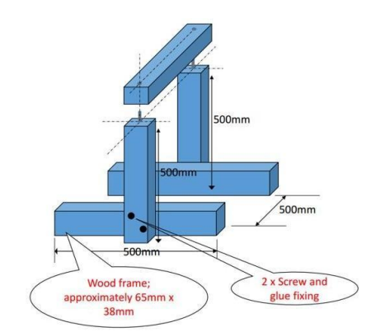
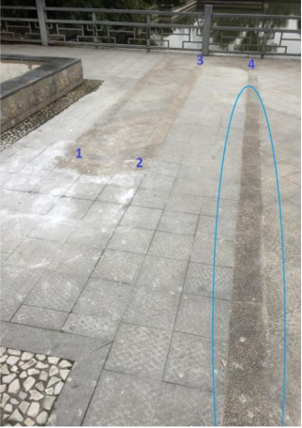
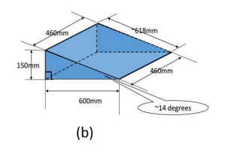
Task Analysis
Patio 1
Task 1
Task 2
Task 3
Fig.1 Pavement inspection
Fig.2 Cross the bridge
Fig.3 Cross the gate

Slide 5
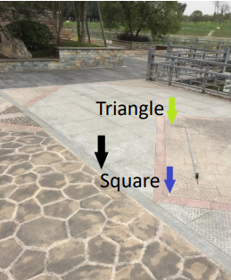
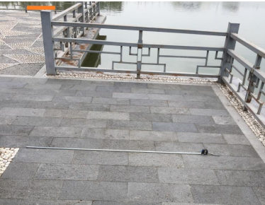
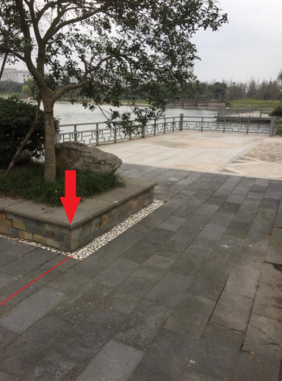
Task Analysis
Patio 2
Task 1
Task 2
Task 3
Fig.4 Arrow Detection
Fig.5 Ball delivery
Fig.6 Communication

Slide 6
Work Allocation
Step 01
Step 03
Work Distribution
Group's Module Improvement
Finish
Start
Team Task Analysis
Step 02
Step 04
Each Group Formation
Intergration & Field Operation

Slide 7
Individual Contribution
Group 1:
Group 2:
Group 3:
Group 4:
Group 5:
All team members made equal contributions !

Slide 8
每个人用模板加上去之类的

Slide 9
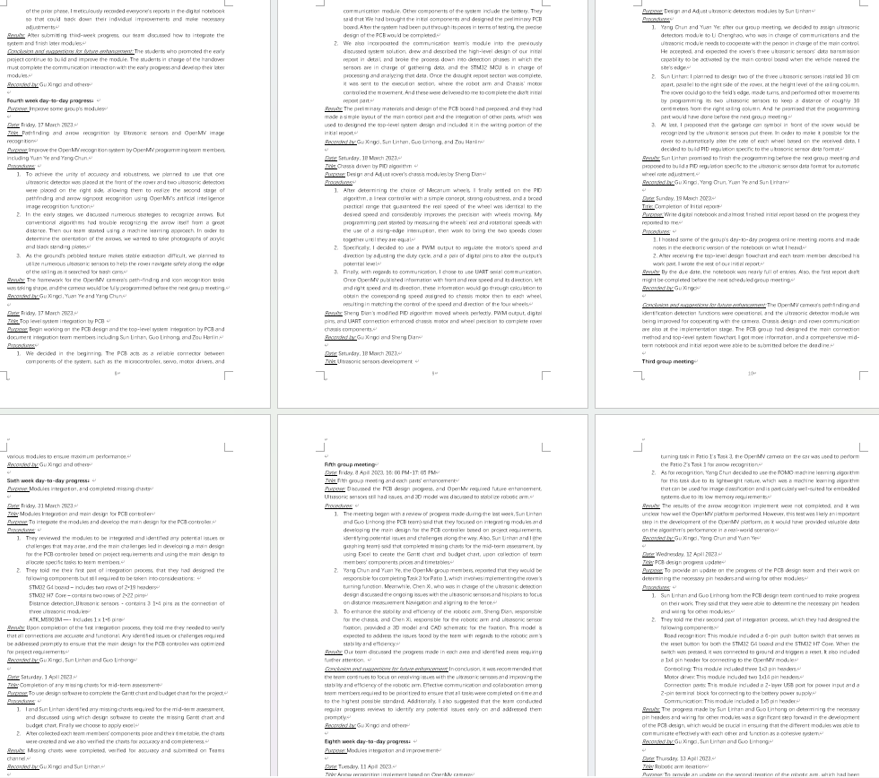

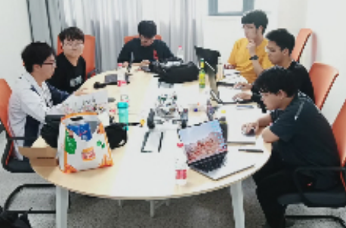
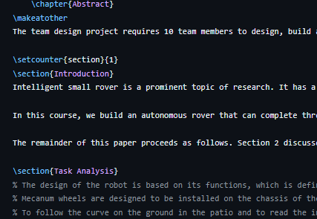

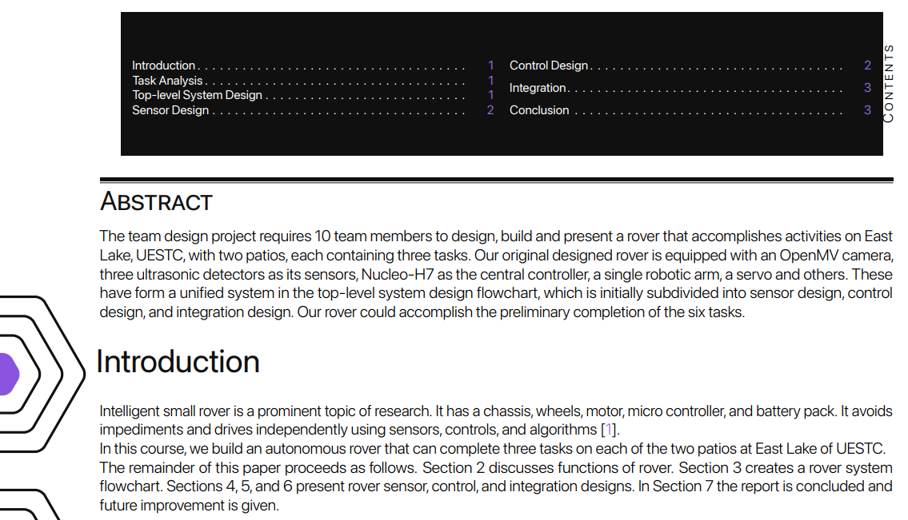

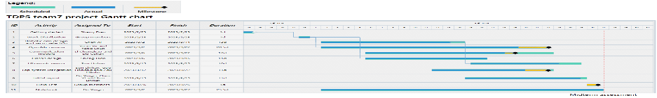
Recording
E-Notebook
Verbal Description
Report
Graphs
Graphs and Typesetting

Slide 10
References
[1]E. Hof, A. Sanderovich, M. Salama, et al. Face verification using mmwave radar sensor[C]. 2020 International Conference
on Artificial Intelligence in Information and Communication (ICAIIC), Fukuoka, 2020, 320­324
[2]F. Lin, C. Song, Y. Zhuang, et al. Cardiac scan: A non­contact and continuous heart­based user authentication system[C].
Proceedings of the 23rd Annual International Conference on Mobile Computing and Networking, New York, 2017, 315­328

Slide 11
参考文献
[1]E. Hof, A. Sanderovich, M. Salama, et al. Face verification using mmwave radar sensor[C]. 2020 International Conference
on Artificial Intelligence in Information and Communication (ICAIIC), Fukuoka, 2020, 320­324
[2]F. Lin, C. Song, Y. Zhuang, et al. Cardiac scan: A non­contact and continuous heart­based user authentication system[C].
Proceedings of the 23rd Annual International Conference on Mobile Computing and Networking, New York, 2017, 315­328
Thanks for your listening
From : TDPS Team 7
Clown vibe Group

